Slide 1
Azure Database for MySQL and MariaDB
L200 pitch deck
Notes:
Azure Database Services for MySQL and Azure Database Services for MariaDB are unique in the public cloud managed OSS database market in that a 99.99% SLA is provided on all pricing tiers, at no additional cost to the customer. This is achieved through the unique architecture of the Azure Database Services platform that enables bringing-up a new database server in the event a server fails, in seconds rather that minutes. In AWS RDS, for example, a 99.95% SLA is only offered if customers deploy their database server in a Multi-AZ configuration – which doubles the cost to the customer.
This unique architecture additionally provides the ability to scale the performance of your database server in seconds, with little/no downtime to your application. This means that you do not have to over-provision a database server to handle peak loads, but rather scale-up as necessary and then scaling back down after a peak event, enabling you to save cost.

Slide 2
Building next generation applications
From transforming products to building innovative web apps, developers use open source to push the envelope of what’s possible
Azure empowers developers with open source-driven services for apps, data, infrastructure and analytics
Azure Database for MySQL and MariaDB illustrate Microsoft’s commitment to open source
Notes:
Technology is omnipresent. It’s shaping how businesses plan for innovation and growth within their markets. The importance of digital transformation is urgent; Since 2000, 52% of Fortune 500 companies are gone due to digital disruption.
We see companies responding by creating digital strategies across four core areas: engaging their customers, empowering their employees, optimizing their operations, and transforming their products.

Slide 3
Choose the database you prefer
MySQL is a leading open source relational database for LAMP stack apps
MariaDB is a community-developed fork of MySQL with strong focus on the user community
v
Enhance your database of choice by uitilizing it as a fully managed service in Azure
Notes:
MySQL is slow to accept large chunks of contributed code
https://mariadb.com/kb/en/library/mariadb-vs-mysql-compatibility/
https://hackr.io/blog/mariadb-vs-mysql
https://blog.panoply.io/a-comparative-vmariadb-vs-mysql

Slide 4
Key use cases for Azure Database for MySQL and MariaDB
Web and mobile apps
Microservices
Read-heavy workloads
Migration
Get to market quickly with LAMP stack
Quickly deploy and scale microservices with Azure Kubernetes Service
Scale out read intensive workloads to ensure high read performance
Reduce database administration by easily migrating to Azure
Notes:
Intelligent apps
Develop sophisticated, transformational apps using state-of-the-art machine-learning algorithms and integrated visualization tools for analytics and actionable insights.
Retail and e-commerce
Build highly secure and scalable e-commerce solutions that meet the demands of both consumer and business customers. Engage customers through targeted products and offers, process transactions quickly, and optimize fulfillment and customer service.
Scalable web and mobile applications
Rapidly build engaging, scalable cross-platform and native apps for iOS, Android, Windows, or Mac.
Digital marketing
Engage with customers around the world with rich, personalized digital marketing experiences. Quickly build and launch digital campaigns that automatically scale based on traffic and customer demand.
Financial management apps
Securely store critical data and provide high-value analytics and insights over aggregated data to users, using built-in security and high availability.
Gaming
Scale your databases elastically to accommodate unpredictable bursts of traffic and deliver low-latency multi-player experiences.

Slide 5
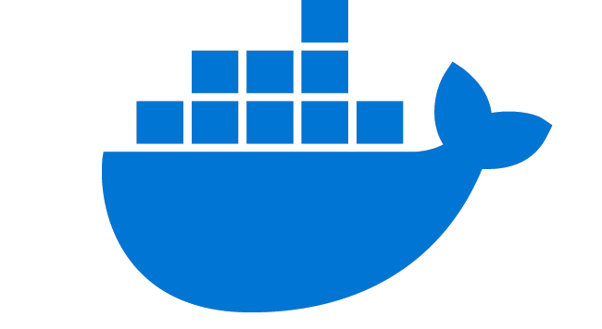

Get to market quickly with the LAMP open source stack
Accelerate time to market by leaving database management to Azure Database for MySQL
Run an Azure Database for MySQL server side-by- side Azure App Service to simplify development
Integrate effortlessly with popular content management systems like WordPress, Drupal, and Joomla
Choose from many languages like PHP, Java, Node.js, and more
Ideal for web apps, digital marketing, and gaming
Scalable open source architecture using Azure App Service environment
Azure Database for MySQL
v
Content Delivery Network
Azure App Service
Redis Cache
Monitoring/ Logging
Users
Docker Hub
Azure Database for MySQL provides a fully managed service that stores vast content as part of the Nobel Prize’s WordPress site
Notes:
https://customers.microsoft.com/en-us/story/nobel-media-media-telecommunications-linux-on-ase

Slide 6

Optimize app development with microservice architectures
Easily integrate with AKS and other managed services for a quicker time to market
Quickly provision databases with microservices architectures and flexibly scale compute and storage
Easily integrate with Azure Kubernetes Service and other managed services to improve deploying and monitoring microservices
Ideal for retail, e-commerce, manufacturing, and banking applications
Microservice architecture with Azure Database for MySQL and Azure Kubernetes Service
Azure Database for MySQL
Azure API Management
Azure Traffic Manager
Azure Kubernetes Service
Users
Azure Application Gateway
Azure Blob Storage
WhiteSource provides greater value to its customers by delivering new services faster and dynamically scaling database resources up and down
Notes:
WhiteSource case study: https://customers.microsoft.com/en-us/story/whitesource-simplifies-deployments-using-azure-kubernetes-service
Inspiration for architecture diagram: https://customers.microsoft.com/en-us/story/siemens-healthineers-health-provider-azure

Slide 7

Optimize performance for read-heavy workloads
Increase performance by deploying read replicas, effectively isolating read and write workloads
Bring applications closer to users around the world by deploying read replicas to other Azure regions
Ideal for read-heavy workloads including BI reporting, social media, web apps, and analytics
Read-heavy workload architecture with read replicas
SQL database
Read Replica #1
Power BI
v
Blob storage
Data Pipelines
Master server
Read Replica #2
Mobile app
Data Lake
Read Replica #3
Desktop app
Fotoable deploys photo-sharing apps around the world with Azure Database for MySQL servers deployed across Azure regions
Notes:
https://customers.microsoft.com/en-us/story/fotoable

Slide 8

Simplify migration and reduce database administration
Free your team from database management by migrating on-premises and IaaS workloads to Azure Database for MySQL or MariaDB
Choose the migration approach that best fits the needs of your workloads
Reduce downtime on critical databases with Azure Database Migration Service*
Ideal for on-premises or IaaS MySQL or MariaDB databases
Options for migrating to Azure Database Services
Discover and assess
DMS Continuous Sync
Azure Database Migration Service
Test
X
Connect to Azure with your favorite tool
Import/Export
Remediate apps
Dump and store
Optimize
Migrate schema and data
GeekWire removed the pain of patching, scaling, and backing up by migrating its WordPress site to Azure Database for MySQL
*Azure Database Migration Service is only available on Azure Database for MySQL
Notes:
https://customers.microsoft.com/en-us/story/geekwire

Slide 9
Using key features

Slide 10




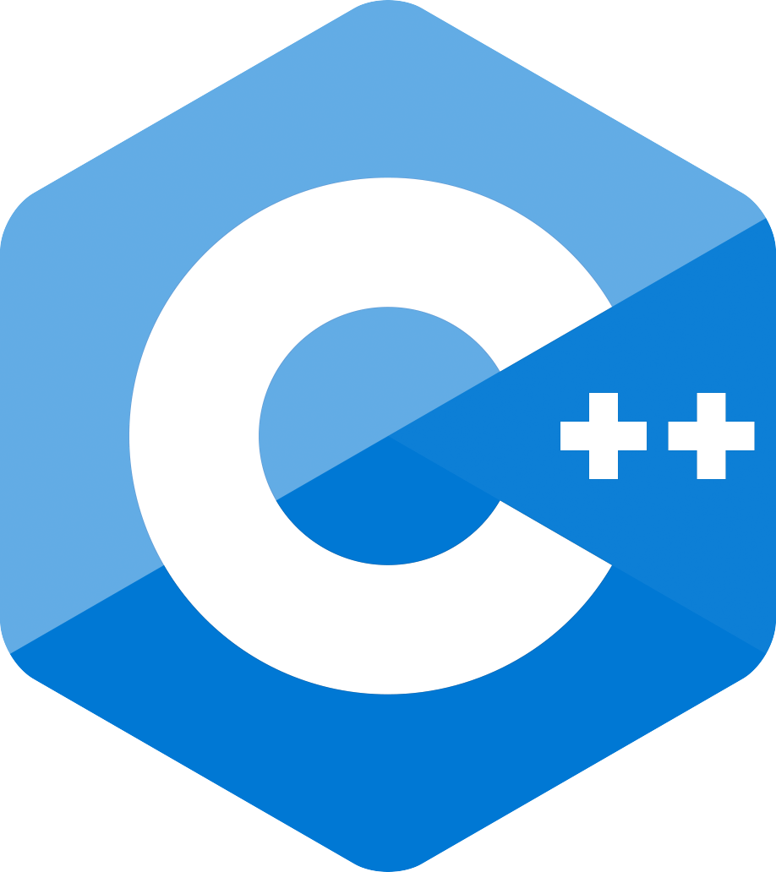
Leverage your choice of versions, languages, and frameworks on a fully managed community database
Azure Database for MySQL is based on the MySQL community edition and supports versions 5.6 and 5.7
Azure Database for MariaDB is based on the MariaDB community edition and supports versions 10.2. and 10.3
Choose from a wide variety of compatible programming languages and drivers to facilitate development
Simplify database management with automatic updates, security fixes, and new feature updates
Node.js
.NET
Ruby

Slide 11
Significantly reduce administration with a fully managed service
Use Azure Portal, Azure CLI, or your custom management app and capitalize on features like:
Built in HA at no additional cost
Reliable performance and pay-as-you-go pricing with several service tiers
On demand scaling within seconds
Protected data at-rest and in-motion
Automated backup and point-in-time- restore for up to 35 days
Azure CLI
Azure Portal
Custom Mgt. App
Azure Resource Manager
Azure Database Services Platform
Database tools
Application
Notes:
Quick start an Azure DB for MariaDB using Azure CLI:
https://docs.microsoft.com/en-us/azure/mariadb/quickstart-create-mariadb-server-database-using-azure-cli
Quick start an Azure DB for MariaDB using the Azure Portal:
Design an Azure DB for MariaDB using Azure CLI:
https://docs.microsoft.com/en-us/azure/mariadb/tutorial-design-database-cli

Slide 12

Monitor your database with Azure Monitor
Azure Database for MySQL and MariaDB tracks performance metrics
Collect, analyze, and take action on telemetry metrics gathered from your database using Azure Monitor
Better understand your database with automatic alerts and insights into resource consumption
Visualize
Dashboards
Views
Power BI
Workbooks
Azure Monitor
Analyze
Metrics
Metric Analytics
Log Analytics
Logs
Respond
Alerts
Integrate
Logic Apps
Export APIs
Notes:
https://docs.microsoft.com/en-us/azure/postgresql/concepts-monitoring

Slide 13
Take advantage of lower TCO with built-in high availability
Get high availability backed with 99.99% SLA guarantees without the need to create a replica
AWS only achieves 99.95% HA with multi-availability zones
Optimize your infrastructure cost by right-sizing your instances based on workload demands
Reduce development and DBA costs associated with performance troubleshooting and alerting
High availability price comparison of Azure Database for MySQL and AWS RDS MySQL
50% savings vs. AWS
50% savings vs. AWS
Notes:
https://docs.microsoft.com/en-us/azure/postgresql/concepts-monitoring

Slide 14





Protect data with layers of security and leading compliance
Azure provides multiple layers of security to safeguard your data
Support for leading compliance offerings
Native authentication
Advanced Threat Protection
Monitor access
Secure SSL connectivity
Server firewall rules
Virtual Network (SE)
Control access
Built-in encryption for data at rest and in motion
Protect data

Slide 15
Protect against malicious action with Advanced Threat Protection
Advanced Threat Protection* (ATP) uses Active Directory signals to identify and investigate user-based threats
After creating a behavioral baseline for each user, Azure ATP detects suspicious activity with built-in adaptive intelligence
Reduce vulnerabilities with configuration insights and suggested best-practices
Decrease alert noise with visibility to simple lateral movement paths and real-time attack timelines
Azure portal
Just turn it on
Advanced threat protection
Actionable alerts
Developer
Azure Security Center (ASC)
*Advanced threat protection only available for Azure Database for MySQL
Notes:
ATP all up
https://docs.microsoft.com/en-us/azure-advanced-threat-protection/
ATP Sizing
https://docs.microsoft.com/en-us/azure-advanced-threat-protection/atp-capacity-planning

Slide 16
Capture query data with Query Store
Query Store simplifies performance troubleshooting by quickly finding the longest running and most resource-intensive queries
Capture a history of queries and runtime statistics by time windows to reveal usage patterns
Opt-in to enable Query Store globally across all of your MySQL and MariaDB databases
Uncovering long query times with Query Store
Query times
Time
Notes:
Query Store simplifies performance troubleshooting by helping you quickly find the longest running and most resource-intensive queries

Slide 17
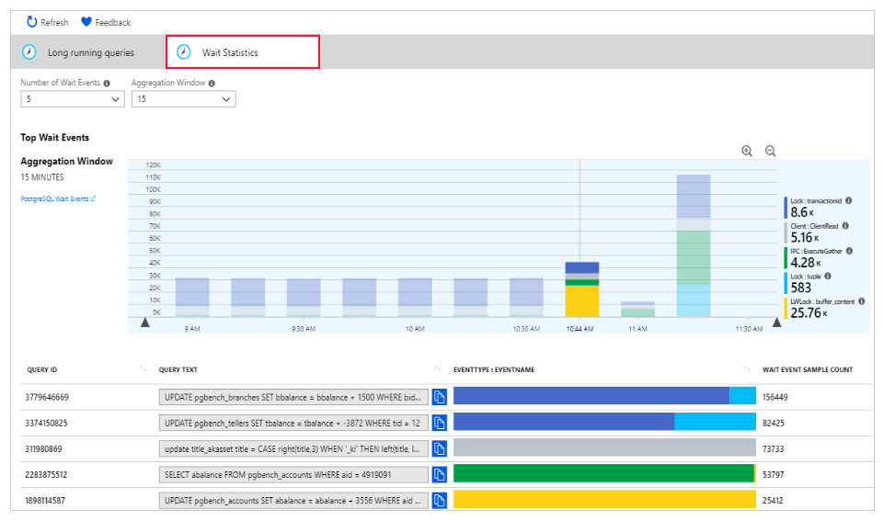
Review performance details with Query Performance Insight
Quickly identify the longest running queries, how they change over time and what waits are affecting them
The Query Performance Insight view in the Azure portal surfaces visualizations on key information from Query Store
The long running queries tab shows the top queries by average duration per execution, aggregated in 15-minute intervals
Users can view additional queries and alter the time window
Wait statistics in Query Performance Insight
Notes:
Query Performance Insight helps you to quickly identify what your longest running queries are, how they change over time, and what waits are affecting them

Slide 18
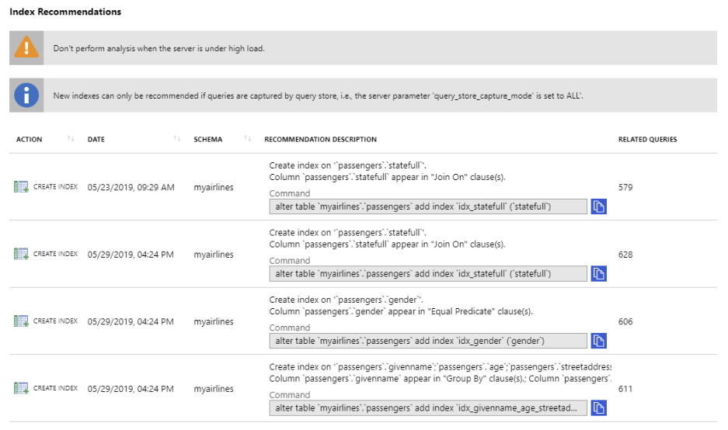
Customized suggestions with Performance Recommendations
Performance Recommendations analyzes your MySQL and MariaDB databases to create customized suggestions for better performance
Create Index recommendations suggest new indexes to accelerate the most frequently run or time-consuming queries
Azure portal performance recommendations
Notes:
Query Store simplifies performance troubleshooting by helping you quickly find the longest running and most resource-intensive queries
Query Performance Insight helps you to quickly identify what your longest running queries are, how they change over time, and what waits are affecting them.
The Performance Recommendations feature analyses your databases to create customized suggestions for improved performance

Slide 19
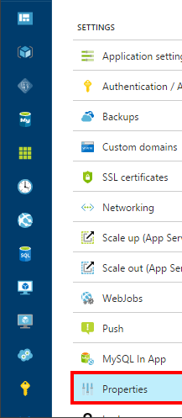
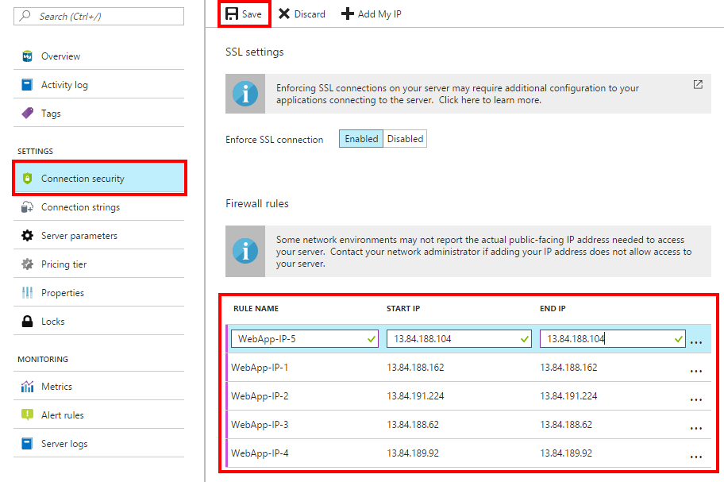
Innovate faster through close integration with Azure services
Intuitive integration with Azure services
Spin up databases during deployment of popular web apps like WordPress and Drupal through Azure App Service
Build apps on microservice architectures with Azure Database for MySQL and MariaDB
Simple database connection to Azure App Service
Notes:
https://docs.microsoft.com/en-us/azure/mysql/howto-connect-webapp
https://azure.microsoft.com/en-us/services/app-service/web/
Easy integration into other services Azure

Slide 20
Service tiers for Azure Database for MySQL and MariaDB
 | Basic | General Purpose | Memory Optimized
Target workload requirements | Light compute and I/O performance | Balanced compute and memory with scalable I/O throughput | In-memory performance and high concurrency
Example uses | Servers used for development, testing, or small scale apps | Hosting web/mobile apps and enterprise apps | Processing real-time data and high-performance apps
vCores | 1, 2 | 2, 4, 8, 16, 32, 64 | 2, 4, 8, 16, 32
Memory per vCore | 2 GB | 5 GB | 10 GB
Storage size | 5 GB to 1 TB | 5 GB to 16 TB** | 5 GB to 16 TB**
Storage type | Azure Standard Storage | Azure Premium Storage | Azure Premium Storage
Database backup retention period | 7 to 35 days | 7 to 35 days | 7 to 35 days
*Azure Database for MySQL also offers Gen 4 compute
**Azure Database for MariaDB supports up to 4 TB
Notes:
https://azure.microsoft.com/en-us/pricing/details/mariadb/
https://docs.microsoft.com/en-us/azure/mysql/concepts-pricing-tiers

Slide 21
Migration resources

Slide 22
Two options to migrate to Azure Database for MySQL or MariaDB
Recommended approach
Option 1
Azure Database Migration Service*
Minimize downtime with continuous sync
Recommended for full database migrations and in-production applications
Option 2
Proof of concept migration
Use dump and restore or import/export for faster migrations
Recommended for testing and proof of concept scenarios only
mysqldump + restore
*Azure Database Migration Service is only available on Azure Database for MySQL

Slide 23
Resources for migration
Database Migration Guide http://aka.ms/datamigration
Azure Database Migration Service Migrate with minimum downtime http://aka.ms/get-dms
Microsoft Azure
Azure Database Migration Service
On-premises workloads
Notes:
Migration guide
Provides prescriptive guidance on how to do migrations. Customers have access to case studies of migrations that other customers already did. Customers will also find a list of partners that they can contact to get assistance to do migrations.
DMS
As organizations look to optimize their IT infrastructure to have more time and resources to focus on business transformation, Microsoft is committed to accelerating these initiatives. The new Azure Database Migration Service (DMS) is a fully managed, first party Azure service that enables seamless and frictionless migrations from heterogeneous database sources to Azure Database platforms with minimal downtime. This service will streamline the tasks required to move existing competitive and SQL Server databases to Azure.
Seamlessly migrate on-premise databases at scale
Experience near zero downtime for mission critical applications
Trust in a robust, resilient service for every migration scenario
Migrate multiple database sources to Azure
*Using DMS to migrate MySQL to Azure Database for MySQL will be at private preview during Azure Database for MySQL GA.
Migrate with minimum migrations
Uploading a large amount of data to the cloud takes some time. Customers cannot always tolerate to stop the application while the database is being migrated. Both DMS and Attunity Replicate For Microsoft Migrations allow customers to migrate with minimum application downtime. The way it works is: while the migration is happening, the data - that users change when using the application- is replicated to the target. The mount of application downtime that customers take is reduced to the time it takes them to points the application to the target (change the connection string, change the definition of the DMS alias…).

Slide 24
Minimize downtime using Database Migration Service
Migrate initial load
New transactions continue to replicate to target until data catches up
Stop new traffic coming in (downtime started)
Wait for last batch of data to catch up
Complete DB migration
Update connection string (back online)
DMS Continuous Sync
Notes:
I have a retail application hosting on on-premise MySQL or Postgres or MariaDB. I setup DMS pipeline to start the migration to move data from source which is my on-premise to target which is Azure Database for MySQL or Postgres. Under the hood, what DMS is doing is migrating the initial load to target. Any new transactions that come in after the initial load will continue to replicate to target until data catches up on the target side.
When the developer is satisfied with the data being sync on the target, what he will do is to stop new traffic from coming into the application. Usually he or she will set the application on maintenance mode, and this stops the new transactions from coming in. We will wait for DMS to catch up and replicate the last batch of data. At this point, target is completely in-sync with the source. Developer will complete the database migration in DMS side and simply update the connection string of the application and point to Azure.
There you have it! Your application now is running live pointing to Azure Database for Postgres or MySQL.

Slide 25
Outperform the competition with Azure Database for MySQL and MariaDB
Cloud HA and scaling | Performance and security
Built-in high availability (HA) and elastic scaling to save time and money with a 99.99% SLA | Enterprise-grade performance and security from Intelligent Performance and Advanced Threat Protection
Azure integration | Truly global reach
Seamless integration with Azure App Service and one-click connections to the Azure ecosystem | 2x global reach vs. AWS RDS

Slide 26
Elevate MySQL and MariaDB with Azure
Fully managed community database
Built-in High Availability for lowest TCO
Intelligent performance and scale
Industry-leading security and compliance
Integration with the Azure ecosystem
Simplify management, improve performance, and innovate faster with Azure Database for MySQL and MariaDB

Slide 27
Call to action
Assess which workloads will benefit from Azure Database for MySQL and MariaDB
Connect with your Microsoft representative to learn more

Slide 28
Documentation and resources
InfoPedia landing page: http://aka.ms/ossdb
MySQL Hands on Lab: http://aka.ms/mysqlhol
MySQL homepage: http://aka.ms/mysql MariaDB homepage: http://aka.ms/mariadb
MySQL documentation: http://aka.ms/mysqldocs MariaDB documentation: https://aka.ms/mariadbdocs
Ask Questions: AskAzureDBforMySQL@service.microsoft.com AskAzureDBforMariaDB@service.microsoft.com
MySQL Videos: https://aka.ms/mysql-azure-videos MariaDB Videos: https://aka.ms/mariadb-azure-videos

Slide 29
Objection handling
Objection | Response
Will I end up paying more with managed service if I’m moving form IaaS or on-premises? | No, you will most likely pay less. IaaS and on prem servers are traditionally over built to handle spikes in workload. Azure Database Services for MySQL and MariaDB allow you to provision in line with your typical workloads but offer the ability to scale-up on the fly as workloads increase. HA is built in with no need for extra replicas.
Will I need to rebuild my app? | No, Azure Database Services are built around the community database engines of MySQL and MariaDB. If your app works outside of Azure, moving to Azure will be painless.
Will I be able to move off of Azure? | Yes, by utilizing the community versions of MySQL and MariaDB you will not be locked into the service and can leave Azure with community tools
Why should I choose Azure for my workloads vs. Amazon, Google, and others? | Competitor cloud vendors not offer indemnification of intellectual property for open source workloads. Microsoft offers the Azure IP Advantage program to protect against lawsuits.
How difficult will it be to move my app to the cloud? | No code changes are necessary to move existing applications to Azure IaaS. Zero downtime is achievable by doing an online migration using Azure Database Migration Services.
MICROSOFT CONFIDENTIAL

Slide 30
Outperform the competition with Azure Database for MySQL and MariaDB
 | Azure Database for MySQL/MariaDB | AWS RDS for MySQL/MariaDB
High availability | No additional configuration required No extra cost from a 2nd node SLA at 99.99% for all open source DB services | Multi-AZ not configured out-of-the-box for HA 2x costs due to required second VM No SLA for single-AZ deployment, 99.95% for Multi-AZ deployment
Performance recommendations | ML-based, intelligent insights and performance recommendations | Performance insights based on historical, static query snapshots only
Service integration | Seamless use of app services for leading developer productivity One click connection to Azure services including Azure Kubernetes Services and BI services | Customers must deploy the database and app separately and stitch them together Requires additional connector for Power BI integration; lack of integration wealth/breadth
Global reach | Currently in 35+ datacenters SLA at 99.99% out of the box | Currently in 17 datacenters SLA at 99.95% for multi-AZ only

Slide 31
Azure Database for MySQL vs. Google Cloud SQL for MySQL
TCO comparison
Azure vs. GCP Standalone Instances (No HA)
The following scenarios compare Azure Database for MySQL 8 vCore instances to non-HA (“standalone instance”) GCP 8 vCore instances with 1 TB of storage:
Azure MySQL 8 vCore General Purpose vs. GCP MySQL db-n1-standard-8
Azure MySQL 8 vCore Memory Optimized vs. GCP MySQL db-n1-highmem-8
Azure (HA) vs. GCP HA² Instances
The following scenarios compare Azure Database for MySQL 8 vCore instances to HA² GCP 8 vCore instances with 1 TB of storage:
Azure MySQL 8 vCore General Purpose vs. GCP MySQL db-n1-standard-8
Azure MySQL 8 vCore Memory Optimized vs. GCP MySQL db-n1-highmem-8
55% savings vs. AWS
57% savings vs. GCP
15% savings vs. GCP
11% savings vs. GCP
Total Monthly Cost:
Monthly storage costs
Monthly compute costs
¹TCO calculated from prices as of October 23, 2018. Assumed 744 hours per month
²GCP only provides high availability (“HA”) when a failover replica is enabled, which is a second instance that effectively doubles a customer’s monthly costs
³GCP has a lower memory to compute ratio than Azure: Azure GP offers 5 GB memory per vCore where as GCP provides 3.75 GB memory per vCPU; Azure MO is 10 GB memory per vCore vs. 6.5 GB per vCPU for GCP highmem instances

